Slide 1
South Africa
Renewable Energy Policy landscape
Policies for an Emerging Market

Slide 2
Emerging vs Mature Markets
In mature markets, focus is on environment, self sufficiency and security of supply
In emerging markets, focus AS ABOVE but in addition…
  Job creation and localisation critical
  Environment important but not at the expense of economic growth…
  Fossil fuels continue to play a dominant role
Therefore policies supporting RE are differentiated based on these drivers

Slide 3
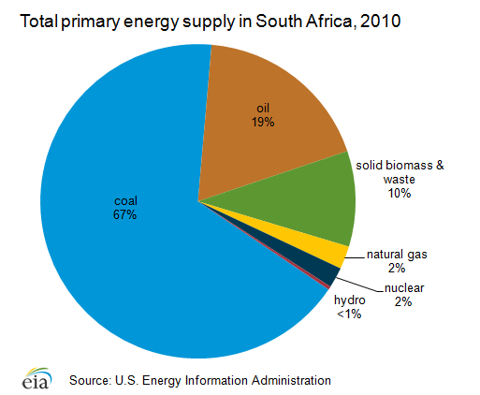
National energy supply

Slide 4
So how has policy development supporting RE taken shape in SA?

Slide 5
Context (South Africa)
Urgent need:
  Reduce fossil fuel dependency
  Reduce carbon footprint
  Diversify energy mix and supply
  Constrained power system (reserve margin less than 5%)
Solution (no panacea)
  Renewable Energy (RE) – resources abundant, sustainable, can be quickly implemented, offer work opportunities and have a much lower impact on the environment

Slide 6

Derisking RE in South Africa
August 1997 South Africa ratified UNFFFC – eligible for GEF funding
Dec 1998 White Paper on Energy Policy – no Renewable Energy target
July 2002 South Africa ratified the Kyoto Protocol (non-Annex - developing country), became eligible for CDM
Nov 2003 White Paper on Renewable Energy Policy - Target of 10 000 GWh (0.8 Mtoe) renewable energy contribution to final energy consumption by 2013, to be produced mainly from biomass, wind, solar and small-scale hydro- This is approximately 4% (1667 MW) of the projected electricity demand for 2013 (41539 MW)
July 2006 Electricity Regulation Act (No 4 of 2006) – Access to the grid, new generation capacity
July 2007 Industrial Policy Action Plan (IPAP) 2007 - Implementation of SA’s Industrial Policy – incorporates renewable energy

Slide 7
Derisking RE in South Africa cont.
Feb 2008 UNDP-GEF funded South African Wind Energy Programme (SAWEP) implemented (Wind Atlas for South Africa (WASA) initiated with Embassy of Denmark co-funding, Wind turbine and component IEC standards adopted, Capacity Credit of Wind Generation in South Africa (funded by GIZ) etc)
May 2008 Darling National Demonstration Wind farm commissioned
July 2008 Long Term Mitigation Scenarios (LTMS) – Cabinet adopted a peak, plateau and decline trajectory. Emissions to peak between 2020 and 2025, remain flat for a decade, and decline in absolute terms from 2030-35 onwards
2008 Energy Act (No 34 of 2008) – establish SANEDI
2009 NERSA approved REFIT
May 2011 Integrated Resource Plan promulgated – 2010 – 2013, 42% (17.8 GW) new build to come from RE (8.4 GW wind, 8.4 GW PV, 1 GW CSP)

Slide 8
Derisking RE in South Africa cont.
2011 Legal issues (procurement) with REFIT
August 2011 Dept of Energy launches RE IPP Procurement Programme – competitive bidding, 70% price, 30% socio-economic development (localisation targets)
Oct 2011 South African Renewable Energy Initiative (SARI) - Aims to design and facilitate arrangements needed to enable a critical mass of renewables be developed with public, private, domestic and international funding, but without incurring unacceptable incremental cost burdens on South Africa
March 2012 Deputy Minister of Energy launched WASA Verified Numerical Wind Atlas for South Africa
Dec 2012 Dept of Environmental Affairs undertook SIP 8: Green Energy SEA initiative for wind (making use of WASA data and tools) and Solar PV – identification of RE development zones (REDZ) - submission for Cabinet approval by 2014
Mature Renewable Energy Industrial Associations (SAWEA, SASTELA, SAPVIA, SABA etc)

Slide 9
RE IPP Procurement Programme (REI4P)
REI4P bid windows:
Bid one: Nov 2011, 28 preferred bidders total 1 415.52 MW
Bid two: May 2012, 19 preferred bidders, total 1043.9 MW
Bid three: Oct 2013, 17 preferred bidders total 1 456 MW
Bid four: Bid Submission Date 31 March 2014, Announcement of Preferred Bidders in respect of Third (CSP) Bid Submission Date 10 June 2014, Signing and effective date of PPAs, Direct Agreements, Implementation Agreements and Connection Agreements and Financial Close not later than 20 February 2015

Slide 10
Exploitable RE resources in South Africa
SA has one of the best solar regimes in the world - most abundant renewable resource in the country (verification underway)
SA has an excellent wind energy resource (confirmed with WASA project), geographically dispersed allowing for security of supply
SA has a world-class wave energy resource, predominantly along the south and west coasts
SA biomass and hydro energy resources are restricted due to limited water
Energy from waste more readily available and exploitable

Slide 11
RE industry/technology in South Africa
Wind energy is a mature technology:
  can be rolled out immediately in SA
  has the potential to establish a local industry for tower and blade manufacturing in the short to medium term
Photovoltaic (PV) systems:
  short to medium term
  different scales, but large-scale local manufacture of PV cells and modules will be challenging.
Concentrated solar power (CSP):
  most promising medium to long term technology for application in SA
  significant advantages including the possibility of establishing a manufacturing industry.
Wave energy convertors:
  still not commercially viable but may have some role in SA in the medium to long term.

Slide 12
Barriers to Rapid Deployment
Policy-linked incentives (tax credits not in place yet)
Skills development
Support for R&D
Support for pilots and demonstration
Awareness/market demand
Development of standards

Slide 13
So where does one start?

Slide 14
A well defined energy policy and climate mitigation landscape
Job creation targets
National Development Plan (2013)
275 Mt CO₂ ‘owned’ by energy sector (IRP 2010)
COP 17, National EE Strategy
Review process, IEP 9date)
IRP 2020 + 34% emission
reduction commitment
(Copenhagen Pledge)
2025: 42 % emission
reduction commitment
(Copenhagen)
RE White paper Target date
EE Strategy Target date
2024: LTMS
550Mt CO₂ ‘cap’
275 Mt CO₂ to be allocated to remainder of economic sectors
IRP 2012
IRP 2014
IRP 2016
IRP 2018
2011
2015
2020
2025
2030
2035
2040
LTMS: Peak
LTMS: Plateau
LTMS: Decline
Time (years) and prominent milestones in the energy policy and climate mitigation landscape

Slide 16
Integrated Resource Plan (2013 Revision)

Slide 17
National Development Plan
A cabinet-approved development plan targeting economic growth (aspirational growth of 5.4% by 2030)
Builds on existing strengths in terms of skills and natural resources
Pronounced focus on energy supply – notably from renewables and gas

Slide 18
LINKAGES BETWEEN IEP/NDP/IRP
INTEGRATED ENERGY PLAN | NATIONAL DEVELOPMENT PLAN | INTEGRATED RESOURCE PLAN
Increase in renewable energy technologies – total installed capacity of renewable energy technologies would be in the magnitude of 26.3% of the total installed capacity by 2030 | Move to a less carbon intensive economy through procuring at least 20 000 MW of renewable energy by 2030 | Development of solar corridors
Wind energy plays a significant role in limiting emissions | Growth and expansion of RE sector | Emphasis on improving energy efficiency regarding transport networks
Alternative renewable energy sources must be sourced | Expand renewable energy sources | NT to use fiscal instruments to subsidise energy R&D
Increased and improved energy efficiency to reduce GHG emissions | Increased and improved energy efficiency to reduce GHG emissions | Innovation is required to improve energy efficiency

Slide 19
RE growth in South Africa to date
Investment of more than $5.5 billion in 2012, up from $30 million in 2011
  Wind energy attracted $1.1 billion of investment
Made South Africa the ninth-leading destination for clean energy investment among Group of 20 (G-20) of the world’s developed and emerging economies
  This after occupying the last spot in 2011
Wind energy capacity grew from 4.5 MW in 2003 to 100 MW (under construction) and 1984 MW (commissioned) by 2014
4TH fastest growing market for RE by % of GDP (2012) – REN 21 Global Status Report

Slide 20
RE growth in South Africa to date
Grid parity for wind and solar energy has been surpassed in SA: electricity cost from new coal plants = $96 /MWh while wind is at $89
DOE and NT enable a Public-Private Partnership Unit (Although PPP regulatory process was not applicable to the REI4P because Eskom is considered a state-own enterprise rather than a government Agency)
The program envisioned the procurement of 3,625 MW over a maximum of 5 tender rounds

Slide 21
Key Facts and Figures from REI4P
Technology | Average tariff (US$/MWh)* - (base Apr '13)
 | 1st Round | 2nd Round | 3rd Round
Wind | 119.5 | 93.8 | 68.5
PV | 288 | 172 | 92.1
Total contribution to SED from wind projects = Mio $ 4.96
Local content requirements | Window I |  |  | Window II |  |  | Window III
 | Current Thresholds | Target | Achieved | Current Thresholds | Target | Achieved | Current Thresholds | Target | Achieved
Wind | 25% | 45% | 21.7% | 25% | 60% | 36.7% | 40% | 65% | 46.9%

Slide 22
Future for RE
REIPPPP success: Socio-economic development, localisation, job creation etc
SARI implementation (market certainty)
Practical RE potential confirmed (ongoing renewable energy resource assessment)
RE generation Capacity confirmed (issues of intermittency, scheduling growing renewable energy supply)
Distributed Generation becoming more important – Smart micro/mini grids leading to localized economic development
Carbon Tax introduction in 2016 – if it goes ahead will have a major impact in promoting RE uptake
Policy and Regulatory framework for self generation, willing buyer, willing seller, net metering etc (opportunities outside the REIPPPP)
Keep learn by doing!!!

Slide 23





See you in Cape Town in October 2015!!
Hosted by Organised by:
Supported by
Federal Government of Germany

Slide 24
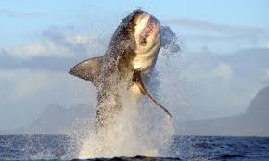
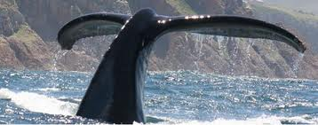
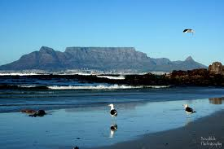
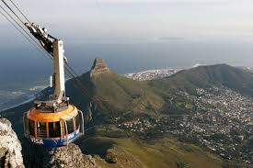
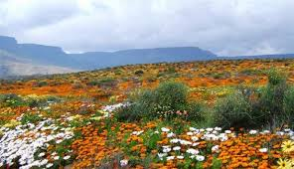
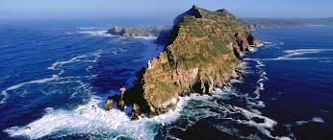
All this plus Renewables too!!!

